Slide 1

Public data

Slide 2
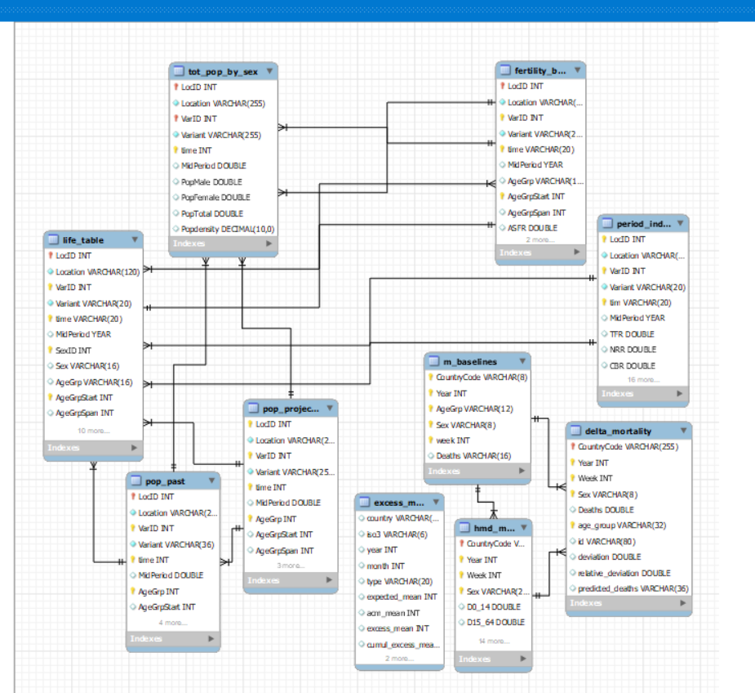
Database

Slide 3

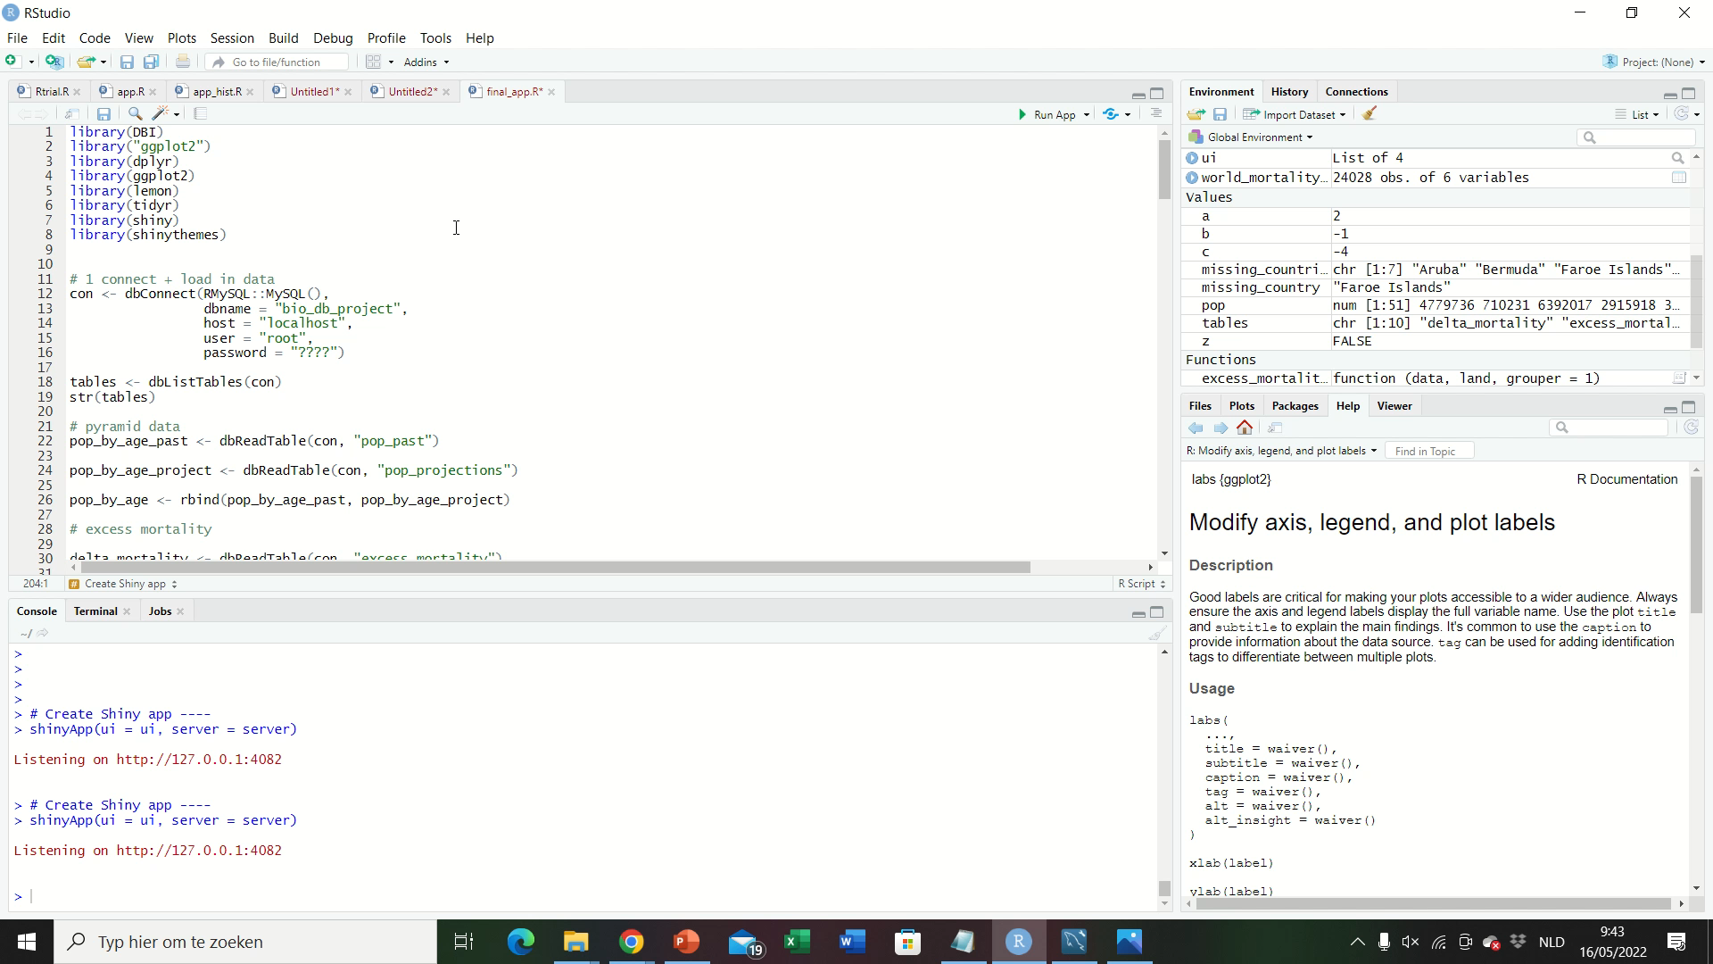
Interactive Rshiny app

Slide 4
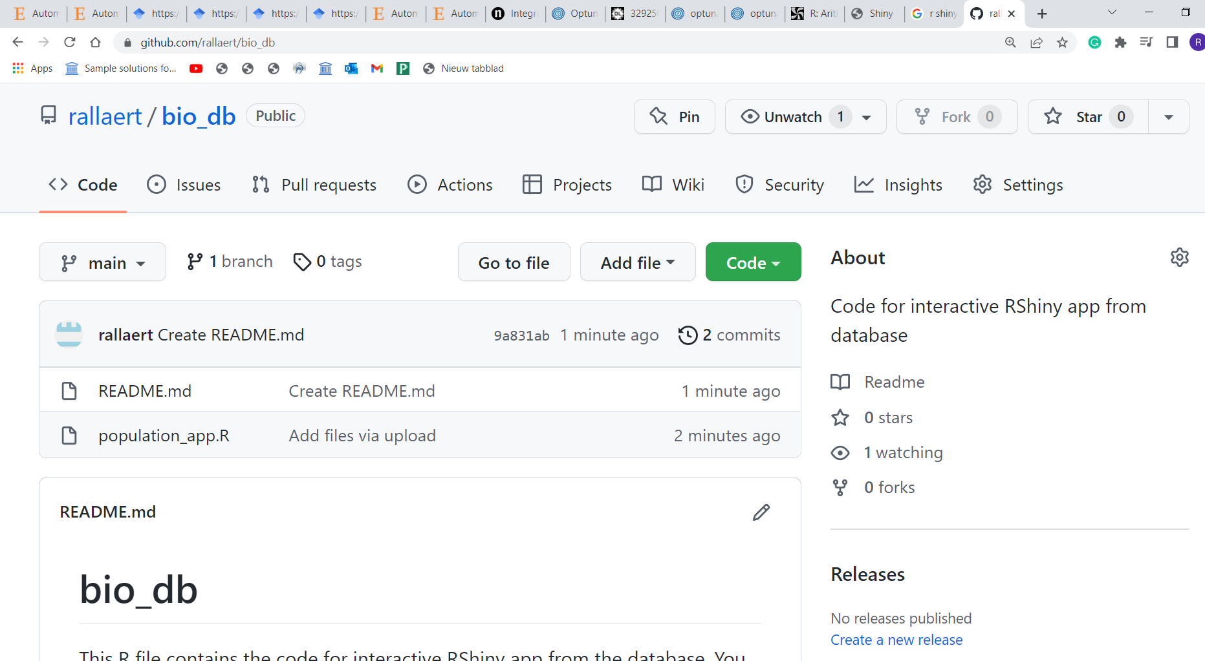
Code available on my github

